Slide 1

Machine learning reveals 3D regulatory mechanisms for height-associated haplotypes
Wanjun Gu, Erin N. Gilbertson, Sergio Baranzini, Rany S. Salem, John A. Capra
American Society of Human Genetics (ASHG) Conference 2024

Slide 2
Presenter financial disclosure
I do not have any relationships to report within the last 24 months with ACCME defined ineligible companies.

Slide 3
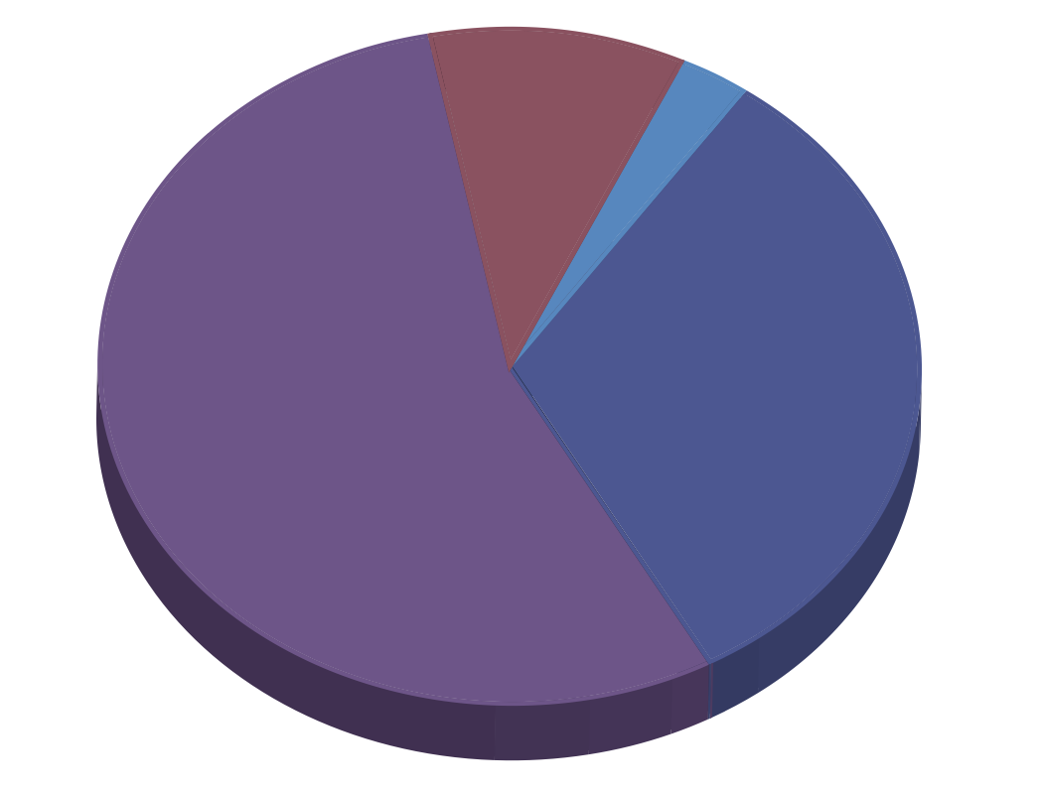

Most GWAS variants are regulatory
GWAS Variants
Coding
Promoter
Non-coding: Intragenic
Non-coding: Intergenic
Corradin and Scacheri, 2014

Slide 4
3D genome folding alters gene expression
Stevens, Lando and Basu, et al. 2017; Credits to Colin Brand for making the loop schematics

Slide 5
3D genome folding alters gene expression
Stevens, Lando and Basu, et al. 2017; Credits to Colin Brand for making the loop schematics

Slide 6
3D genome folding alters gene expression
Stevens, Lando and Basu, et al. 2017; Credits to Colin Brand for making the loop schematics

Slide 7
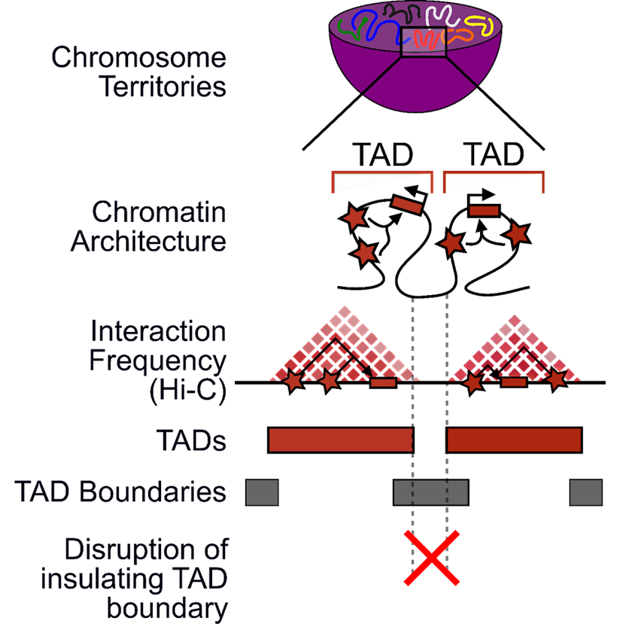
Disrupting 3D genome organization influences rare and common traits
McArthur and Capra, 2021

Slide 8
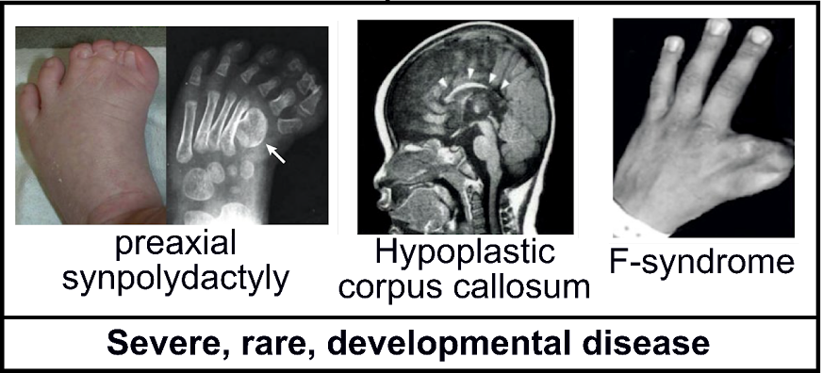
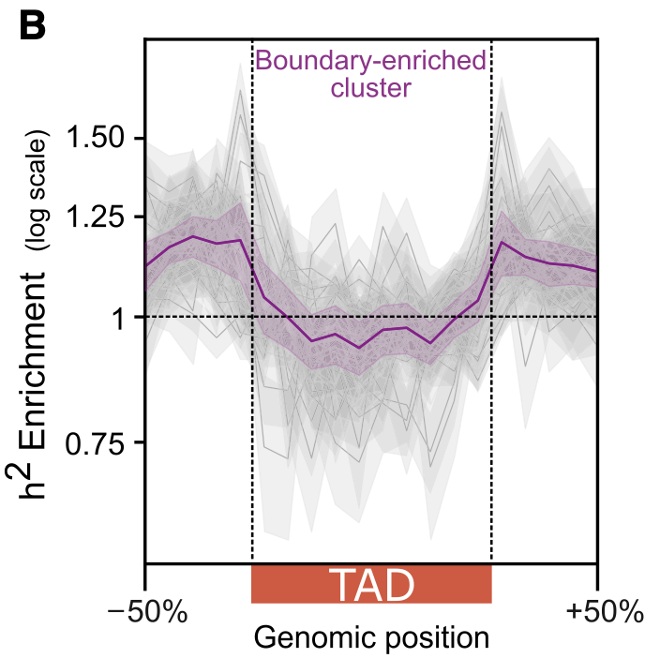
Disrupting 3D genome organization influences rare and common traits
via large structural variation
Via small common variation
McArthur and Capra, 2021
Notes:
Heritability enrichment landscape over TADs for traits in the boundary-enriched cluster (n = 22). The gray lines represent the heritability pattern for each trait in the cluster; the purple line is the average over all the traits.

Slide 9
Question
Do disruptions in 3D genome folding play a regulatory role in genetic factors associated with common traits?
Two innovations enable answering this question:
Comprehensive height GWAS
Sequence-based machine learning method predicting 3D genome folding
Yengo, Vedantam and Marouli et al. 2022; Fudenberg et al. 2020

Slide 10
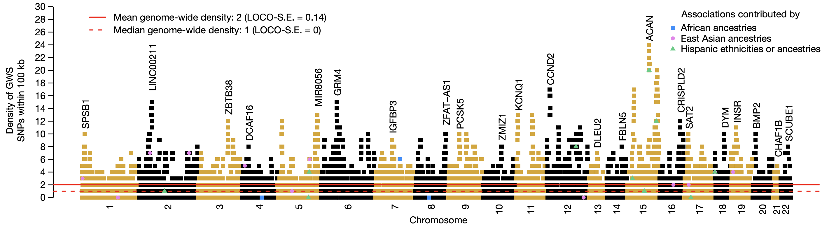
Most common height-associated variants in humans have been identified
12,111 height-associated SNPs identified from ~5.3 million individuals
Yengo, Vedantam and Marouli et al. 2022
Notes:
Cite yengo

Slide 11
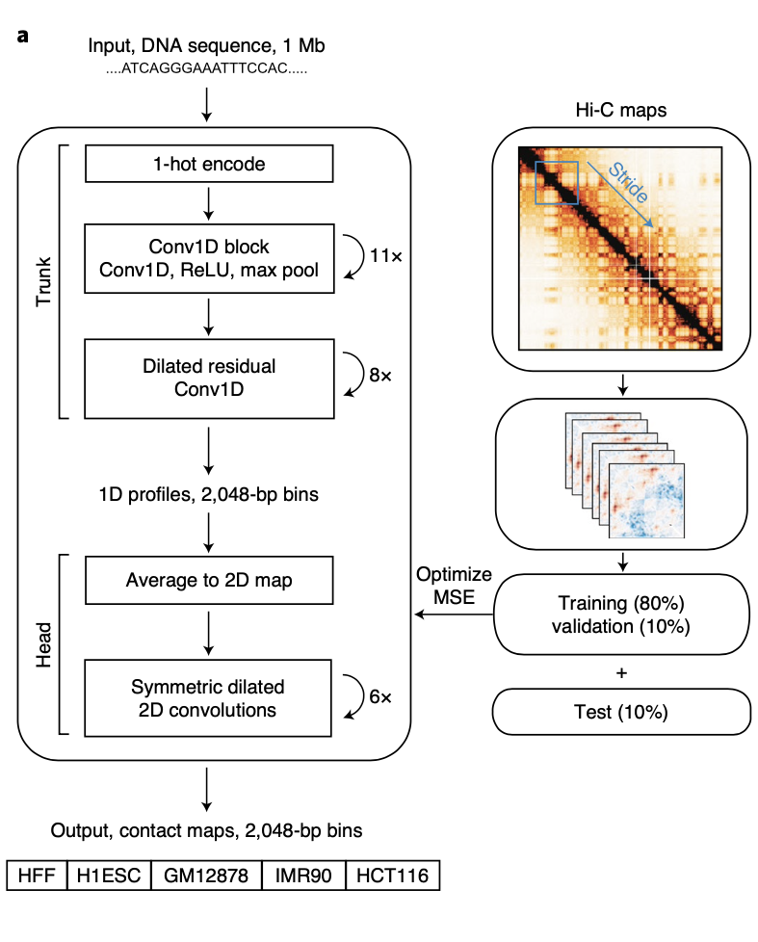

3D genome folding can be predicted in-silico
Fudenberg et al. 2020
Notes:
Sequence plays a large role
Deep learning model can learn these relations
What goes in, what comes out
Do in-silico mutagenesis -
Cell types: HFF human foreskin fibroblast - one with the highest resolution celltype in the training set
Cite pollard

Slide 12
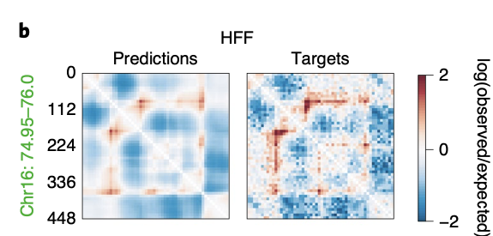
3D genome folding can be predicted in-silico
Fudenberg et al. 2020
Notes:
Sequence plays a large role
Deep learning model can learn these relations
What goes in, what comes out
Do in-silico mutagenesis -
Cell types: HFF human foreskin fibroblast - one with the highest resolution celltype in the training set
Cite pollard

Slide 13
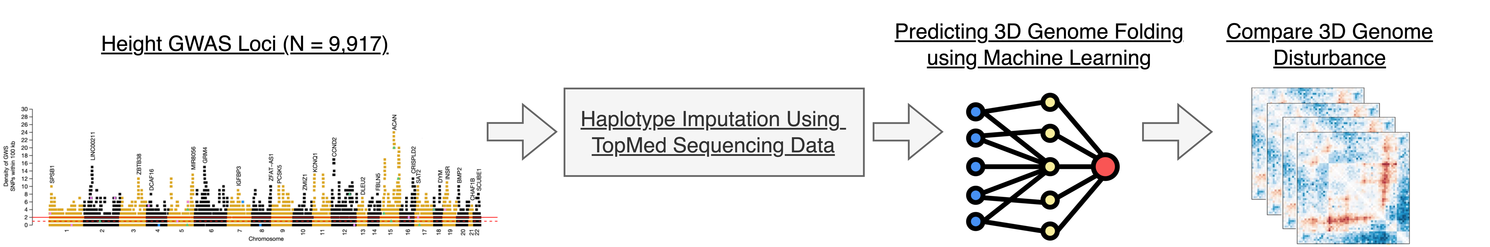
Predicting 3D-genome disturbance of height-associated loci

Slide 14
Predicting 3D-genome disturbance of height-associated loci

Slide 15
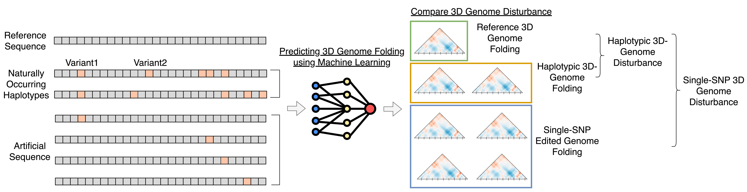
In-silico mutagenesis creates height-associated and single-SNP-edited haplotypes

Slide 16
In-silico mutagenesis creates height-associated and single-SNP-edited haplotypes

Slide 17
In-silico mutagenesis creates height-associated and single-SNP-edited haplotypes

Slide 18
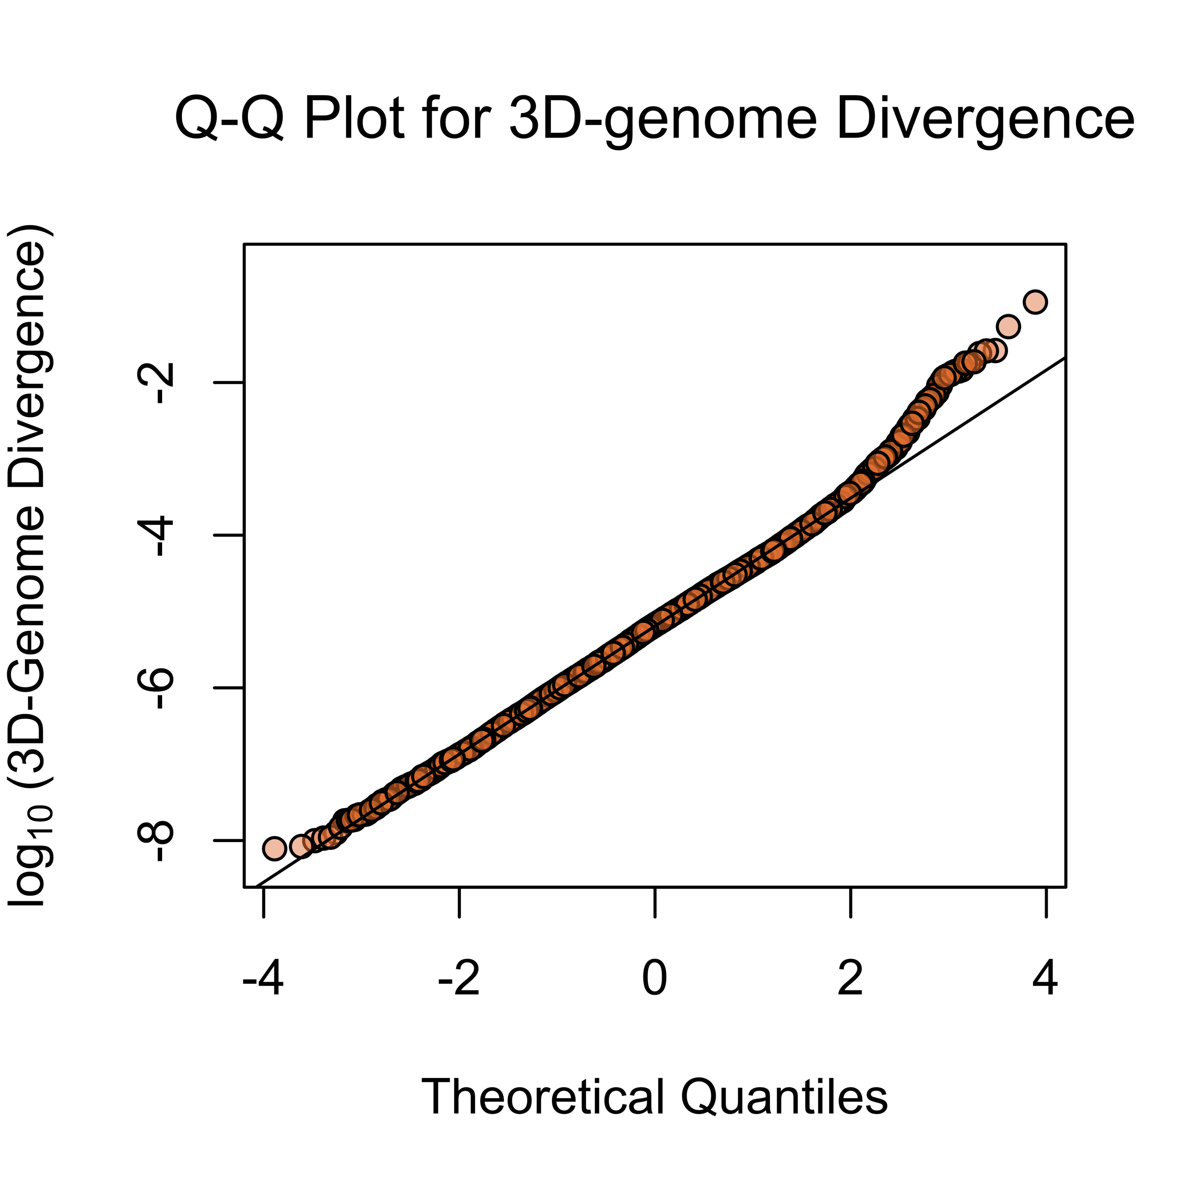
Only a small number of height-associated loci influence 3D-genome folding
Examined 9917 height-associated regions
107 regions (top 1.08%) exhibited substantial divergence (> 0.001)
17 regions (top 0.17%)
demonstrated extreme disturbance (> 0.01)
Gilbertson et al. 2024

Slide 19
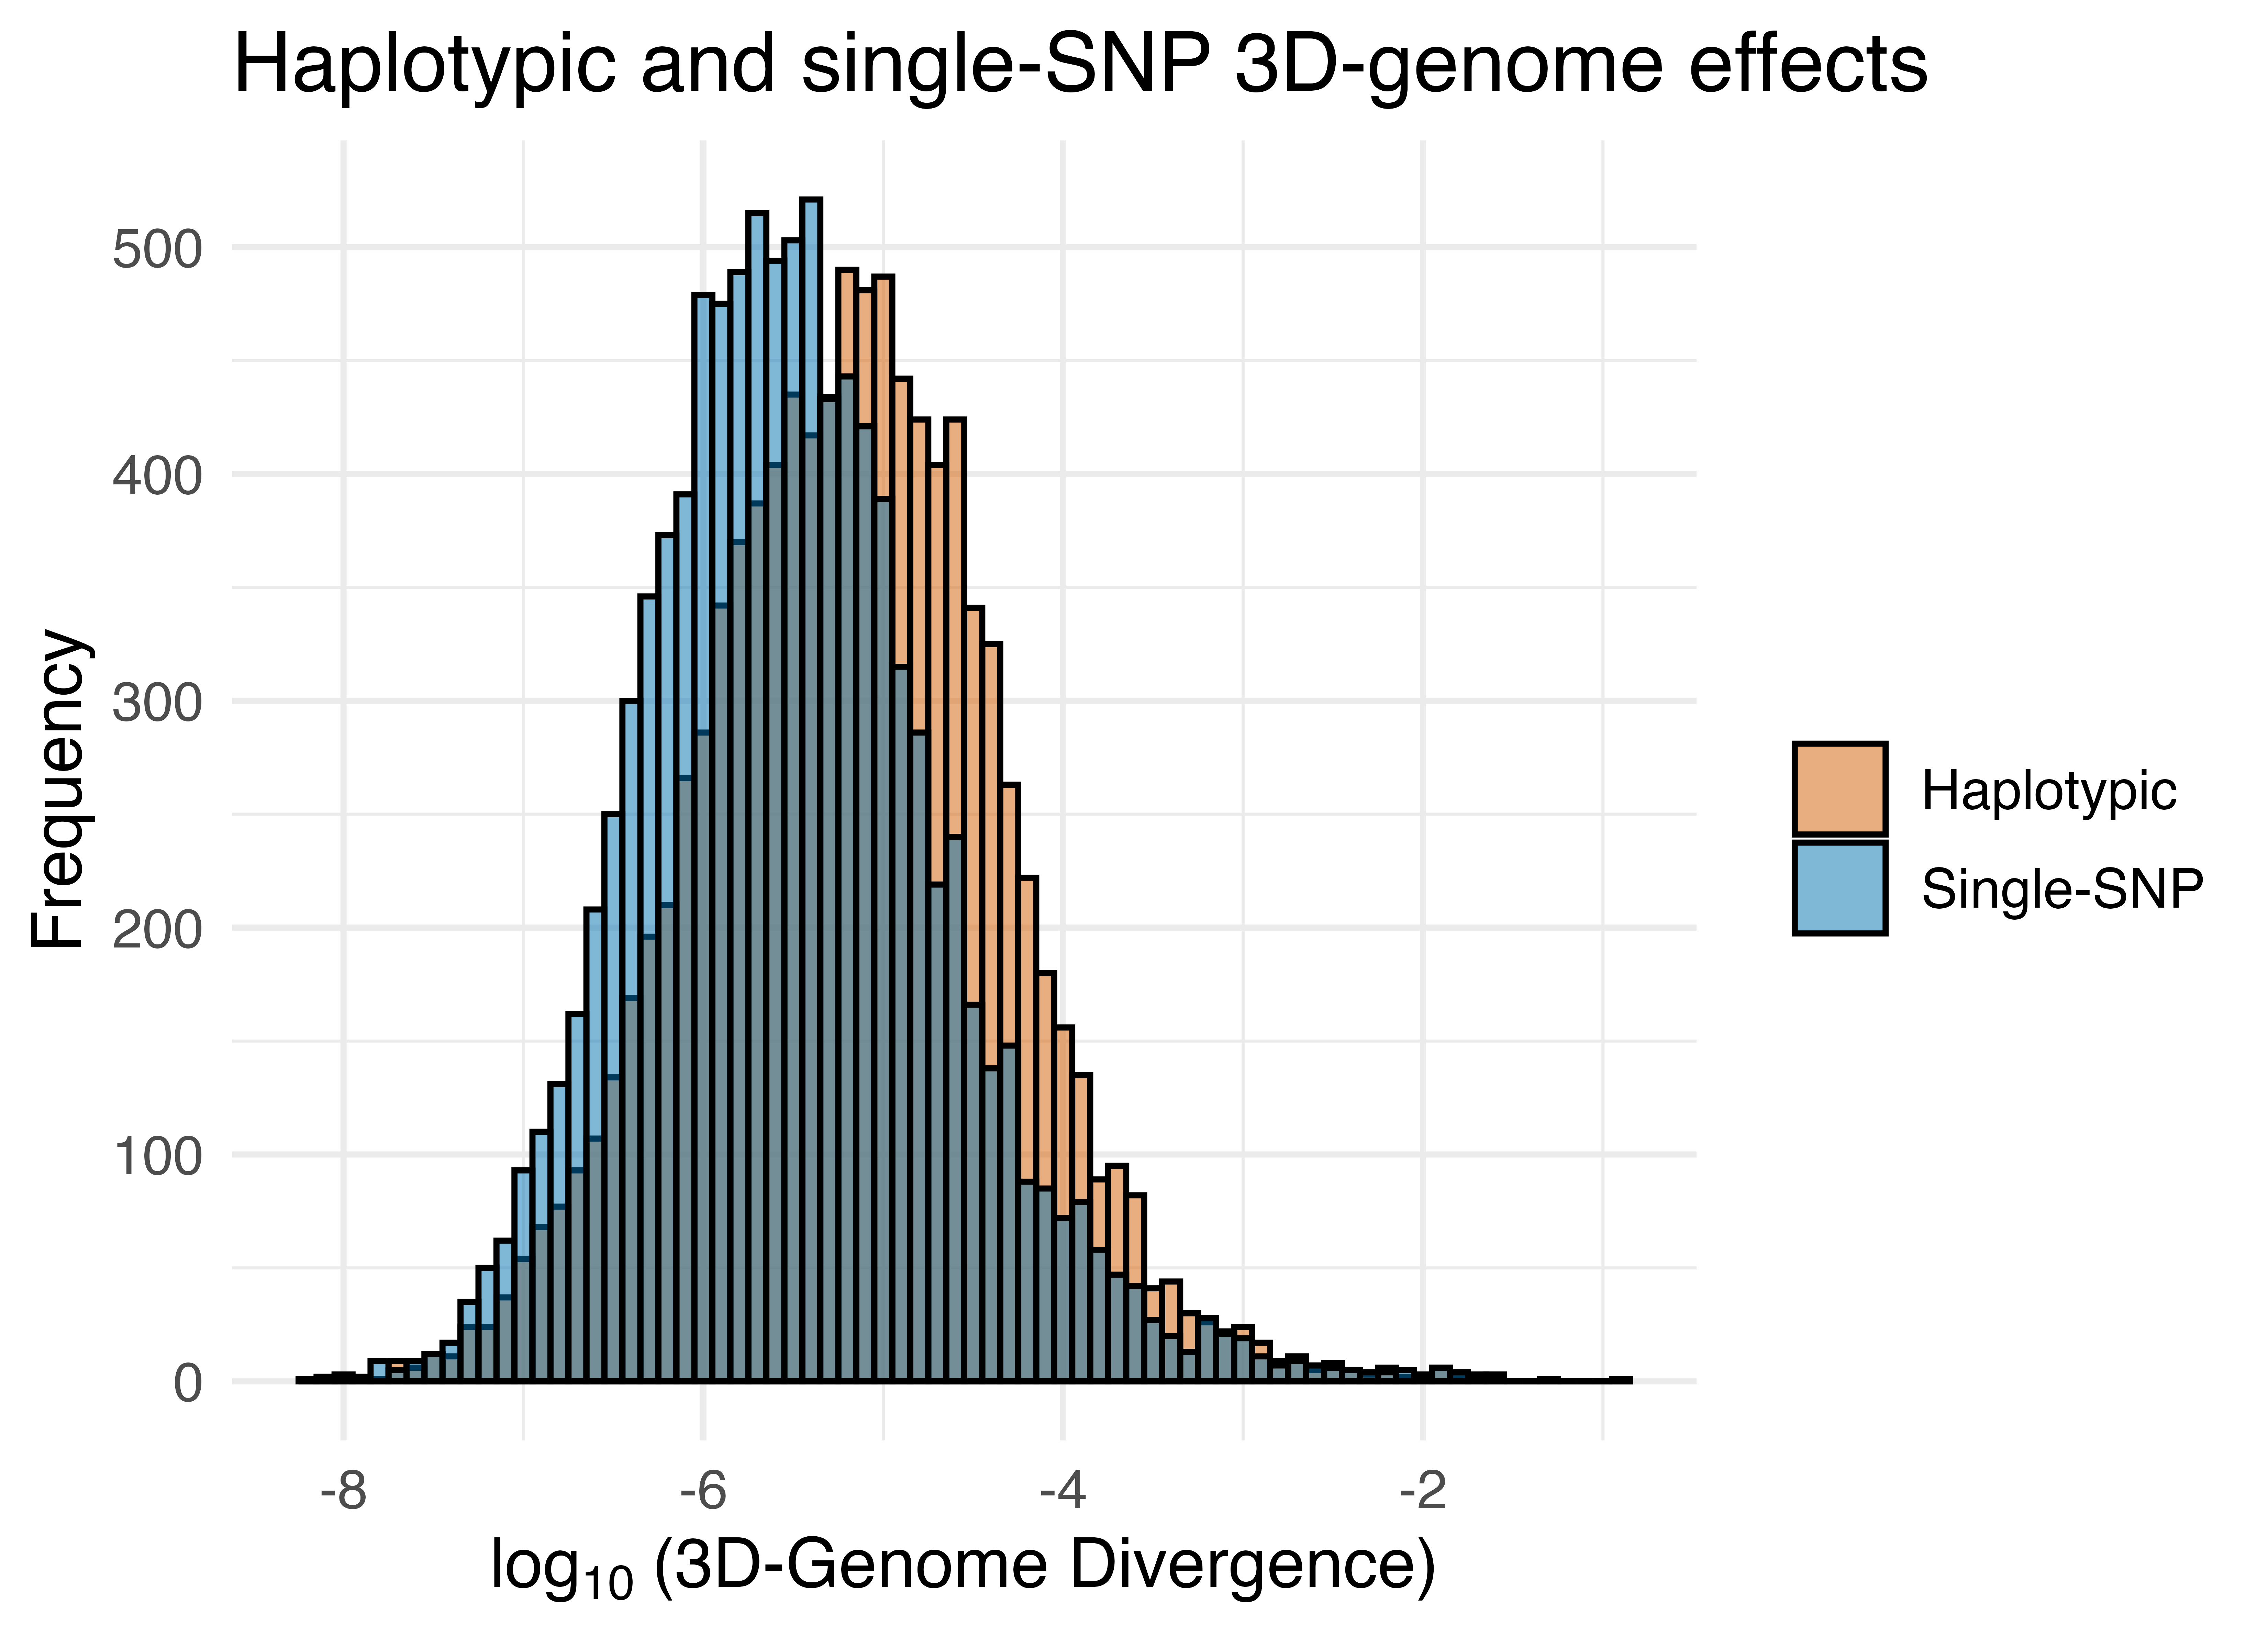
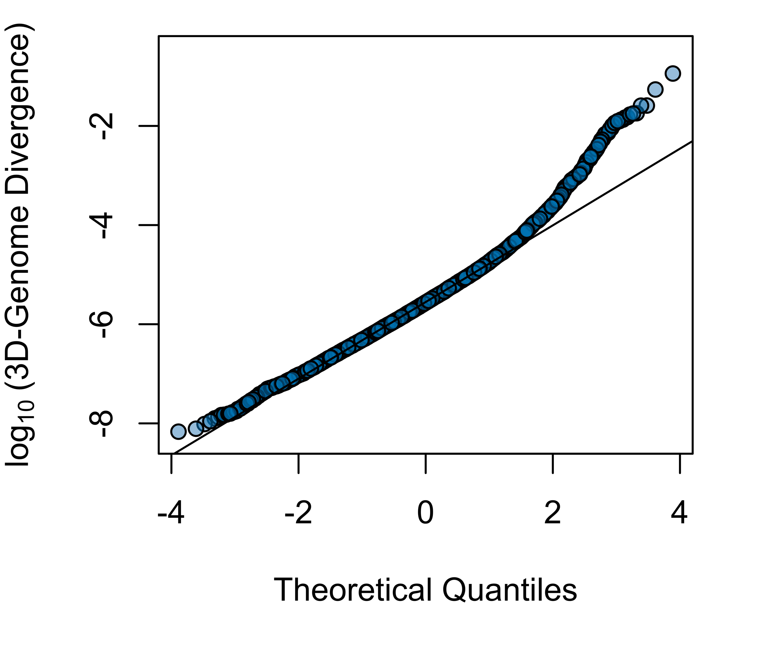
Combined haplotypic disturbance is on average greater than single-SNP disturbance
Haplotypic Divergence
Single-SNP Divergence

Slide 20
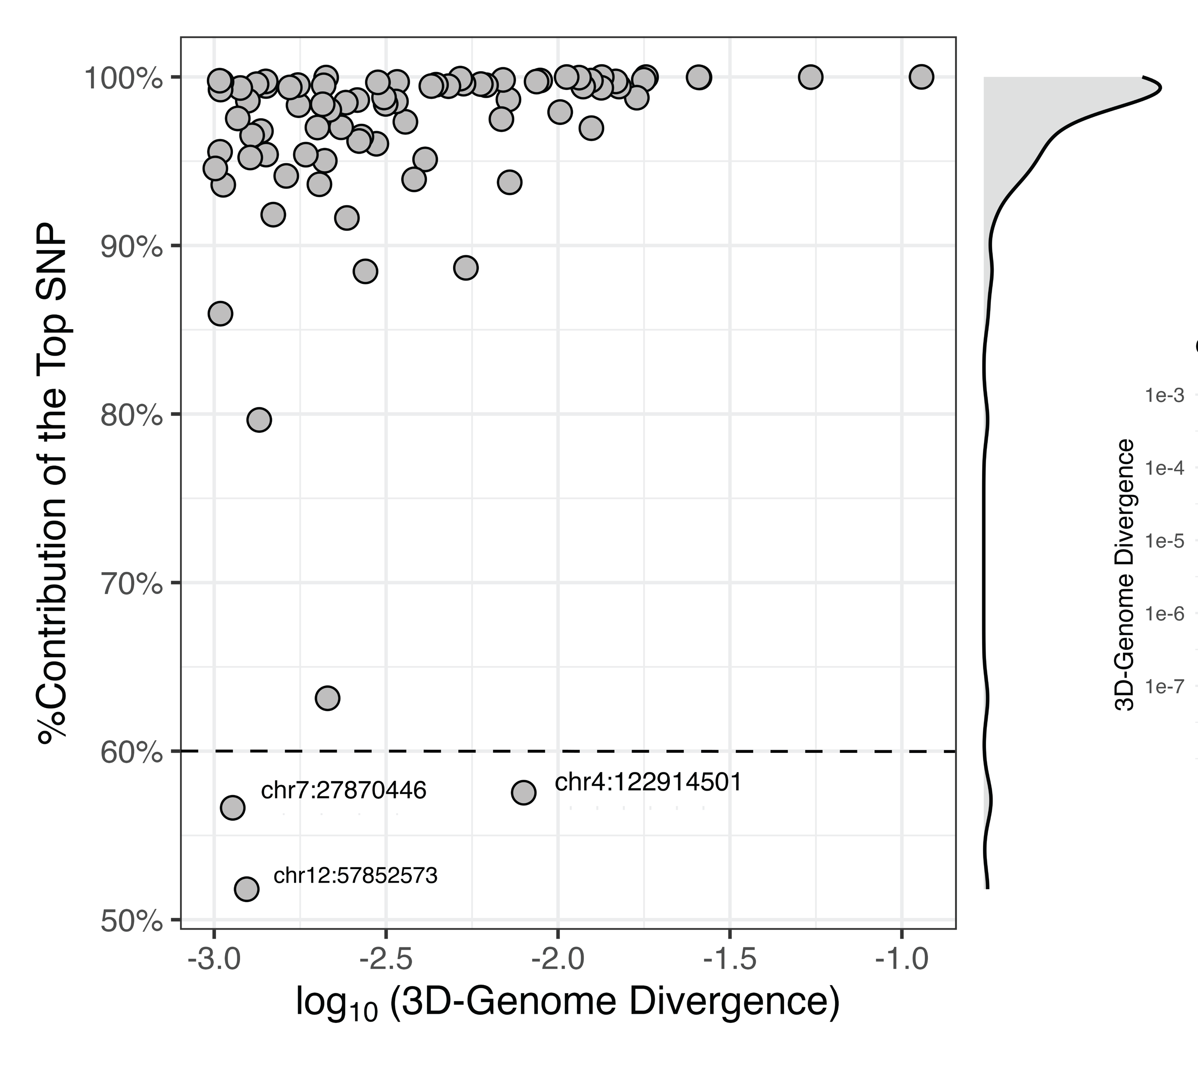

Most 3D-genome-altering haplotypes are driven by single SNPs

Slide 21
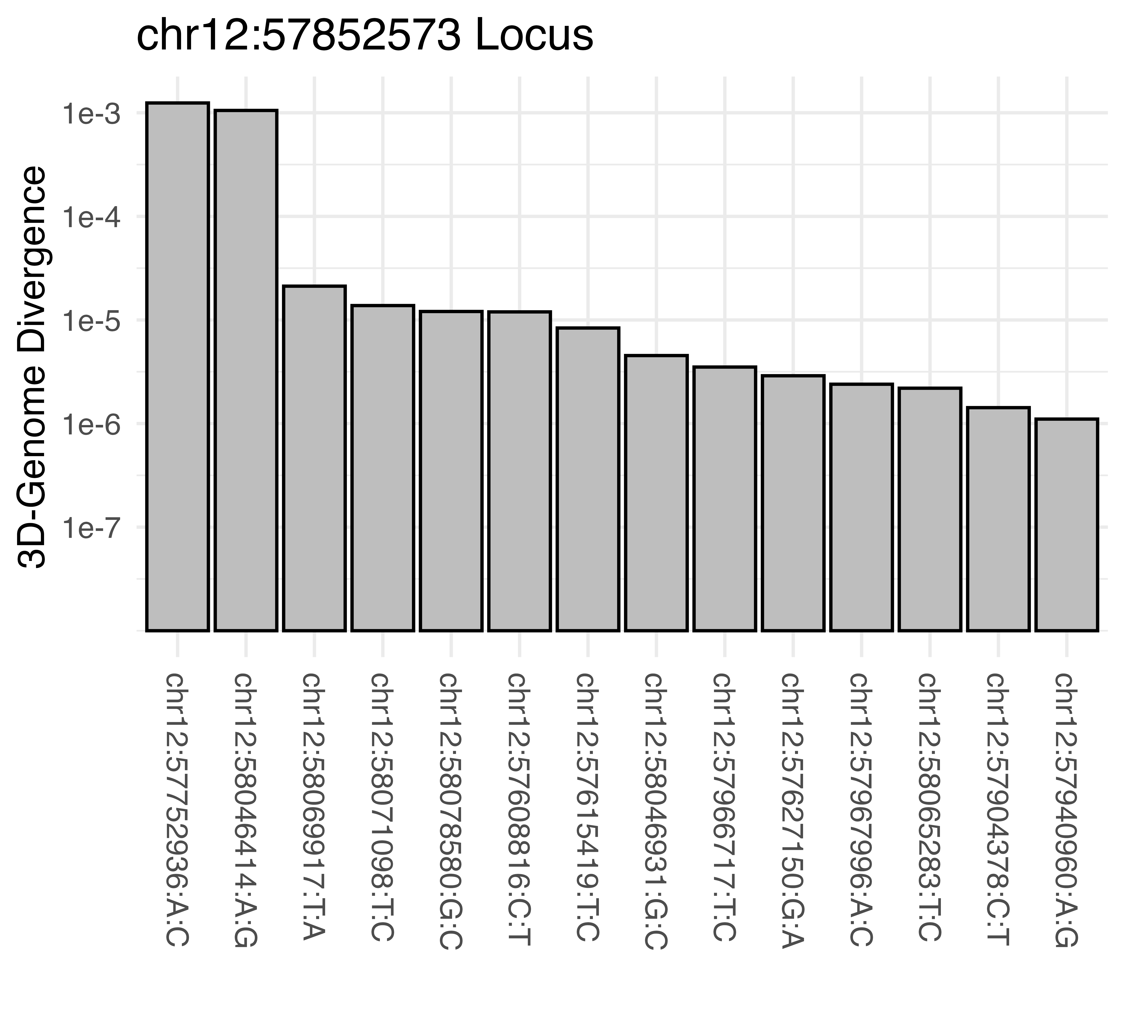
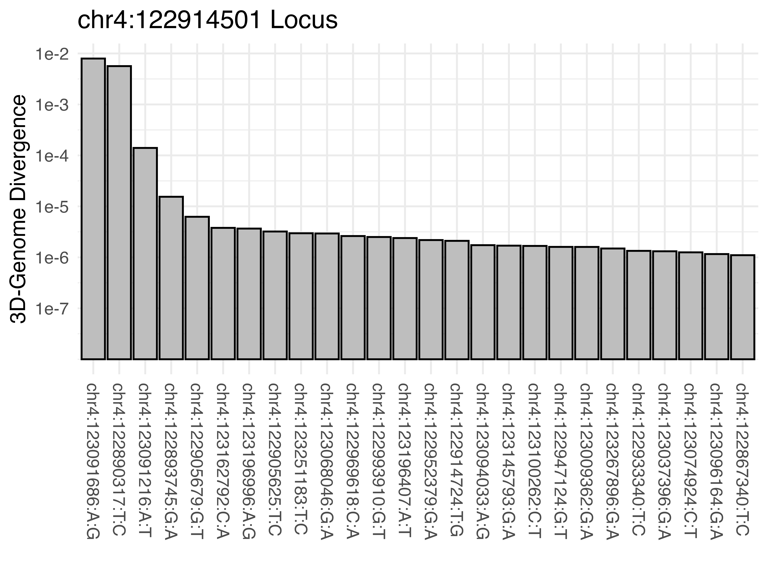
Most 3D-genome-altering haplotypes are driven by single SNPs with a few exceptions

Slide 22
Most 3D-genome-altering haplotypes are driven by single SNPs with a few exceptions

Slide 23
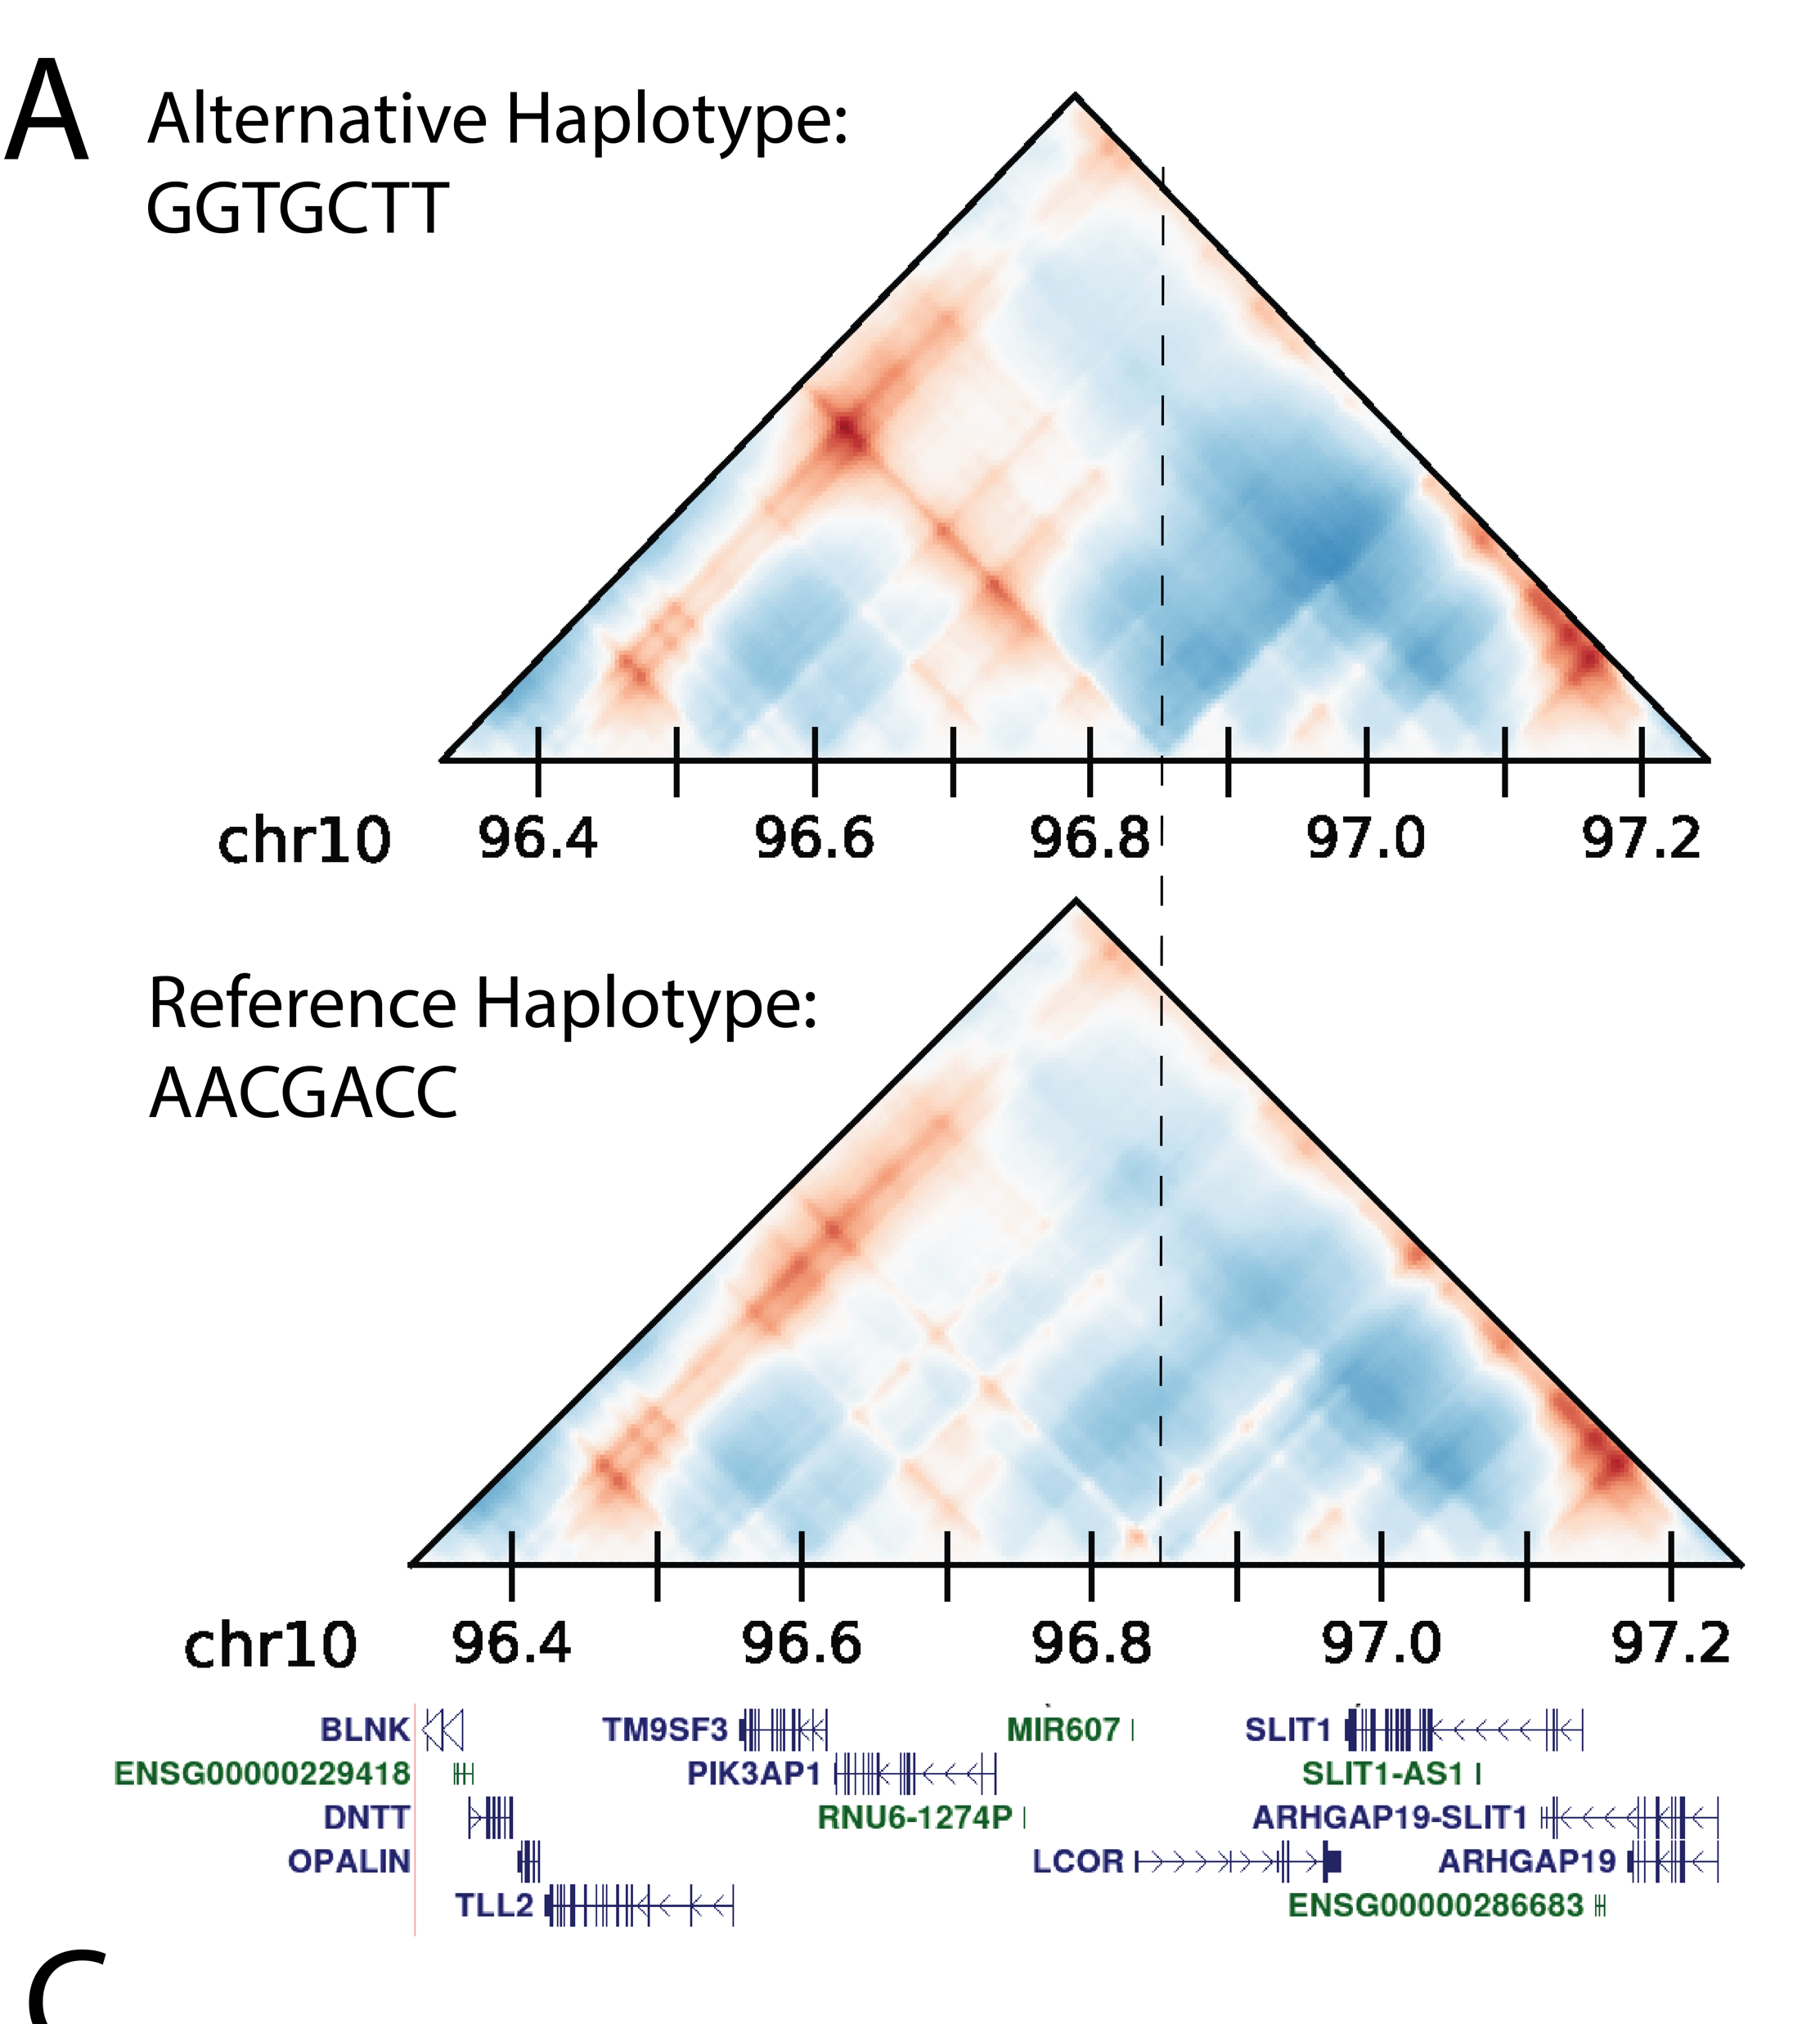

The top 3D-genome disturbing region localized near the promoter of LCOR

Slide 24
The top 3D-genome disturbing region localized near the promoter of LCOR
Ligand Dependent Nuclear Receptor Corepressor

Slide 25
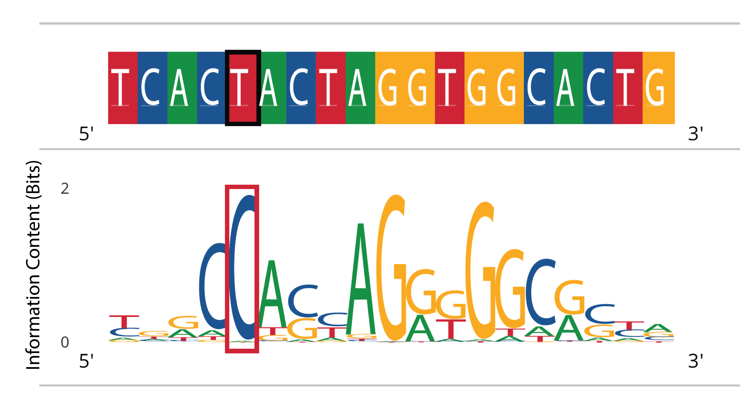
The top 3D-genome disturbing region localized near the promoter of LCOR
CTCF-binding site
LCOR promoter variant rs7477274 is:
- Associated with height
- The top 3D-genome disturbing variant

Slide 26

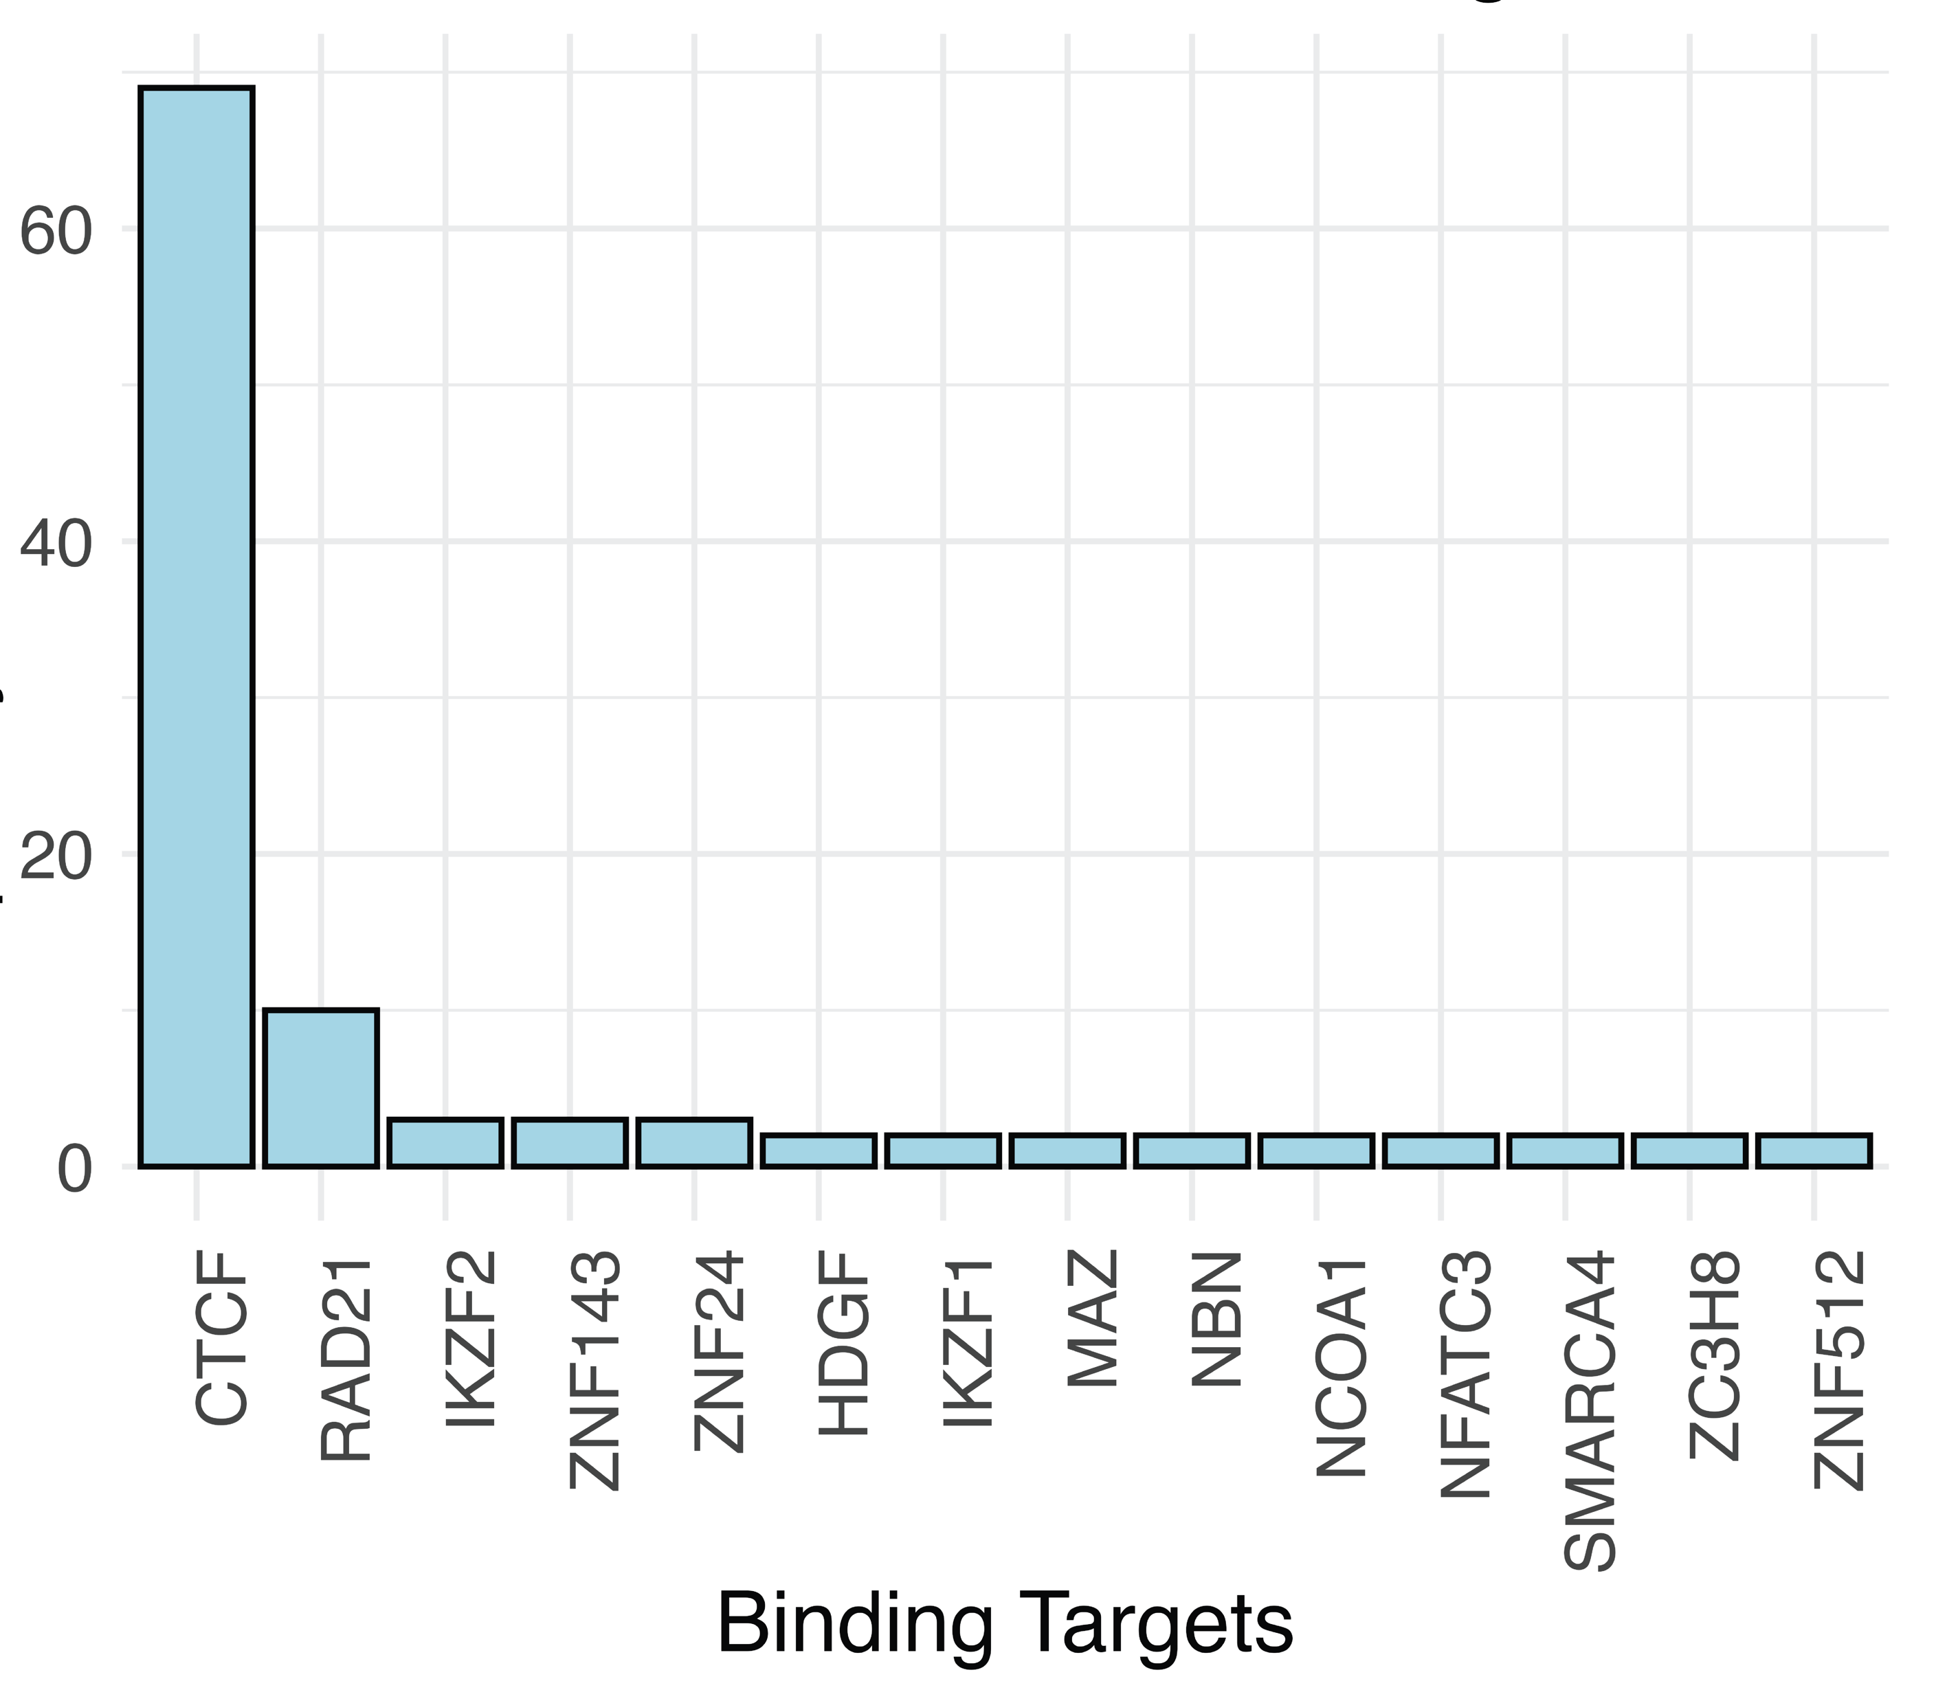
rs7477274 likely modifies genome-folding at LCOR across tissues
LCOR rs7477274 Locus Binding Pattern
Number of Biosamples
The ENCODE Project Consortium, 2012

Slide 27
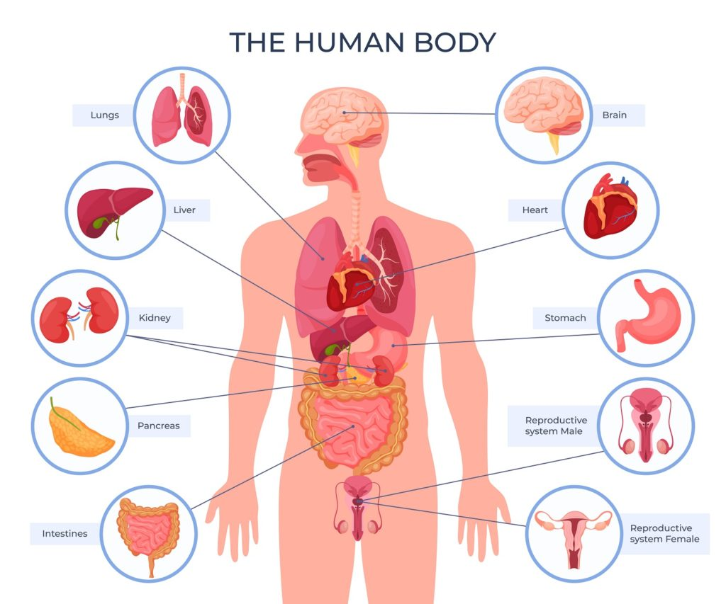
rs7477274 likely modifies genome-folding at LCOR across tissues
LCOR rs7477274 Locus Binding Pattern
Number of Biosamples
The ENCODE Project Consortium, 2012; Image from: homehealth-uk.com

Slide 28
rs7477274 likely modifies genome-folding at LCOR across tissues
LCOR rs7477274 Locus Binding Pattern
Number of Biosamples
The ENCODE Project Consortium, 2012; Image from: homehealth-uk.com

Slide 29
Conclusion
A small fraction of height-associated loci show evidence of 3D-genome disruption.
The top locus is in the promoter of LCOR and disrupts a CTCF binding motif.
This study highlights the use of sequence-based machine learning methods to fine-map GWAS signals and propose molecular mechanisms.

Slide 30








Acknowledgement
Erin Gilbertson
Colin Brand
GitHub Repository
Sergio Baranzini
Rany Salem
Tony Capra
Study preprint available soon

